Slide 1
HELM & KUSTOMIZE
Kubernetes resource management
Michal Okresa
michal.okresa@unicorn.com
Anton Lysina
anton.lysina@unicorn.com

Slide 2
Agenda
The Problem
Kustomize overview
Kustomize in action
Helm basics
Helm advanced
Example
Helm basics
Helm charts for app frontend, backend and database

Slide 3
The problem
Deployment of application is quite complex task. To deploy containerized application into Kubernetes cluster, several objects needs to be created and parametrized and according to these objects the Kubernetes creates and manages the application inside the cluster and provides such application the necessary resources needed for application run.

Slide 4
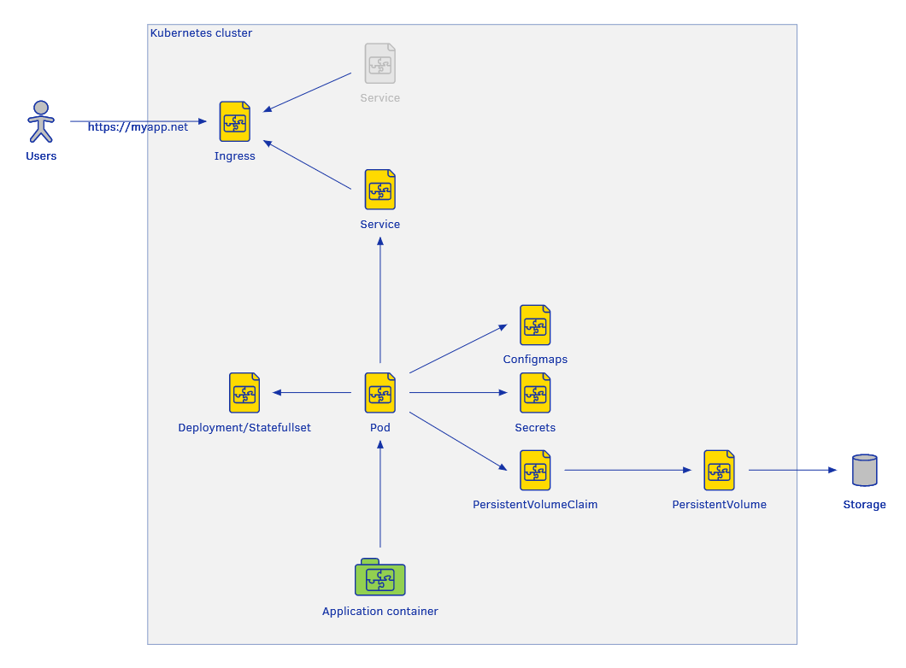
Example of K8s application deployment
kubectl apply -f deployment.yaml
kubectl apply -f service.yaml
kubectl apply -f configmap.yaml
...

Slide 5
Kustomize it!

Slide 6
Kustomize introduces a template-free way to customize application configuration that simplifies the use of off-the-shelf applications.

Slide 7
Kustomize it!
Get resource definition
Kustomize It
Deploy

Slide 8
Kustomize overview
Base
Kustomization or root containing all references to the resources and components
Overlay
An overlay is a kustomization that depends on another kustomization. An overlay is unusable without its bases.
Component
special type of kustomization that allows one to define reusable pieces of configuration logic that can be included from multiple overlays.

Slide 9
Kustomize overview
├── base
│ ├── deployment.yaml
│ └── kustomization.yaml
├── components
│ ├── external_db
│ │ ├── configmap.yaml
│ │ ├── dbpass.txt
│ │ ├── deployment.yaml
│ │ └── kustomization.yaml
│ ├── ldap
│ │ ├── configmap.yaml
│ │ ├── deployment.yaml
│ │ ├── kustomization.yaml
│ │ └── ldappass.txt
│ └── backend
│ ├── deployment.yaml
│ └── kustomization.yaml
└── overlays
├── basic
│ └── kustomization.yaml
├── standard
│ └── kustomization.yaml
└── enterprise
└── kustomization.yaml

Slide 10
Kustomize overview
# $basic/kustomization.yaml
apiVersion: kustomize.config.k8s.io/v1beta1
kind: Kustomization
resources:
- ../../base
components:
#- ../../components/external_db
#- ../../components/ldap
- ../../components/backend
# $standard/kustomization.yaml
apiVersion: kustomize.config.k8s.io/v1beta1
kind: Kustomization
resources:
- ../../base
components:
- ../../components/external_db
#- ../../components/ldap
- ../../components/backend

Slide 11
Basic overrides
image
Registry, repository, image, tag
Namespace
Name prefix/suffix
Patches
Replacements

Slide 12
What is Helm?

Slide 13
Helm
HELM is a package management utility, which provide templating mechanism and values injecting feature which allows to implement the reusable Kubernetes application deployments, which can be parametrized with proper values during the deployment.
HELM provides the possibility to create (or use existing) public (or corporate) application repository for reusable application deployment. So, if we need to install some application, for which the HELM installation already exists, we can simply connect to this application database and reuse deployment objects from this database. We also can create our own HELM installation database either public or corporate one.
Helm deploys charts, which you can think of as a packaged application. It is a collection of all your versioned, pre-configured application resources which can be deployed as one unit.
Package managers from different areas: Windows installer, apt, yum, npm, NuGet, …

Slide 14
Helm – cluster connection
Because Helm installs the Kubernetes objects into Kubernetes cluster, there needs to be connectivity between Helm executable command and Kubernetes API, where the Helm executable sends the parametrized Kubernetes deployment objects
use current Kubernetes client connectivity configuration (preferred variant)
~/.kube/config
KUBECONFIG="path/to/your/kubeconfig"
parametrize each Helm executable invocation with connectivity info (inline config)

Slide 15
Helm 2 vs. Helm 3
Helm in version 2 was used only as helm client binary (on your local machine) and it was connected to tool called Tiller. At first helm have to be initialized, by installing Tiller in to k8s cluster. After that, all communication between your helm client and k8s cluster goes through Tiller component.
Tiller keep tracks of all your deployments and rollbacks.
Helm in version 3 act without Tiller and connect directly to K8s API. Helm3 keep tracks of your deployments, by storing information in Helm secrets in k8s-namespace where you deployed your app.

Slide 16
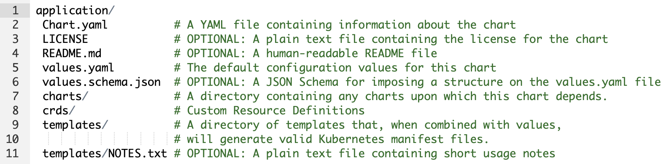
Helm Charts
Helm Charts are parametrized Kubernetes YAML manifests combined into a single package that can be deployed to your Kubernetes clusters
A chart is a collection of files that describe a related set of Kubernetes resources. A single chart might be used to deploy something simple, like a memcached pod, or something complex, like a full web app stack with HTTP servers, databases, caches, and so on.

Slide 17
Helm Release
A Release is an instance of a chart running in a Kubernetes cluster. One chart can often be installed many times into the same cluster. And each time it is installed, a new release is created. Each one will have its own release, which will in turn have its own release name.
Example:
helm install nginx bitnami/nginx -n nginx --create-namespace
helm upgrade nginx bitnami/nginx -n nginx
helm uninstall nginx -n nginx
helm list -n nginx

Slide 18
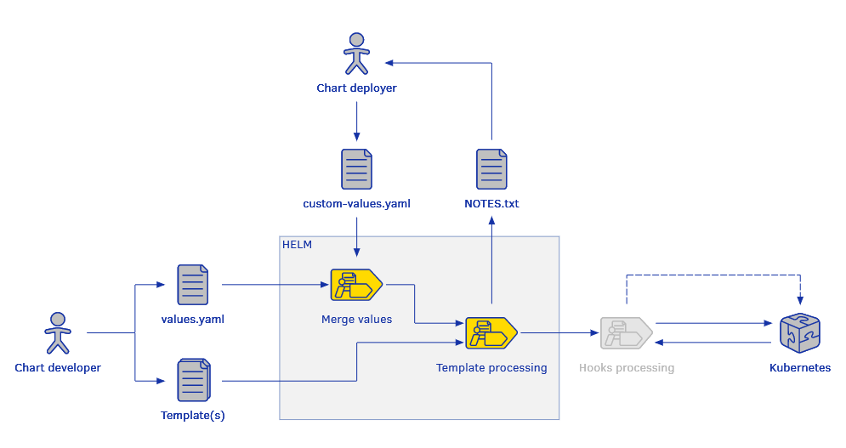
Helm Templates
Templates are used with Helm to produce the result Kubernetes yaml manifests, which can be deployed to Kubernetes cluster.

Slide 19
Hooks
Hooks provides a way how to connect some functionality to various lifecycle states of the helm chart template processing and installing. Hooks allow the chart developer, an opportunity to perform operations at strategic points in a release lifecycle.
* https://helm.sh/docs/topics/charts_hooks/#hooks-and-the-release-lifecycle
Hook Type | Description
pre-install | Executes after templates are rendered, but before any resources are created in Kubernetes
post-install | Executes after all resources are loaded into Kubernetes
pre-delete | Executes on a deletion request before any resources are deleted from Kubernetes
post-delete | Executes on a deletion request after all of the release's resources have been deleted
pre-upgrade | Executes on an upgrade request after templates are rendered, but before any resources are updated
post-upgrade | Executes on an upgrade request after all resources have been upgraded
pre-rollback | Executes on a rollback request after templates are rendered, but before any resources are rolled back
post-rollback | Executes on a rollback request after all resources have been modified
test | Executes when the Helm test subcommand is invoked

Slide 20
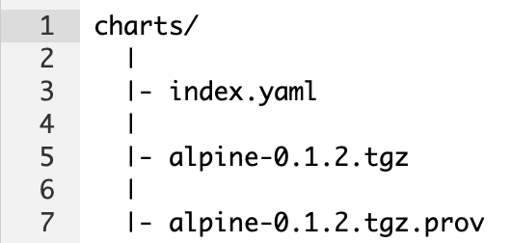
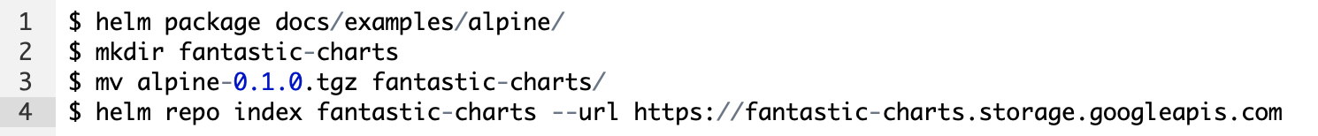
Helm Repositories
A chart repository is an HTTP server that houses an index.yaml file and optionally some packaged charts. When you're ready to share your charts, the preferred way to do so is by uploading them to a chart repository.
GoogleCloud Storage (GCS) bucket,
Amazon S3 bucket,
GitHub Pages,
or even create your own web server

Slide 21
Helm Chart Starter Packs
The helm create command takes an optional --starter option that lets you specify a "starter chart”
As a chart developer, you may author charts that are specifically designed to be used as starters. Such charts should be designed with the following considerations in mind:
The Chart.yaml will be overwritten by the generator.
Users will expect to modify such a chart's contents, so documentation should indicate how users can do so.
All occurrences of <CHARTNAME> will be replaced with the specified chart name so that starter charts can be used as templates.

Slide 22
Helm advanced
Required vs schema validation
https://helm.sh/docs/howto/charts_tips_and_tricks/#using-the-required-function
https://helm.sh/docs/topics/charts/#schema-files
Named templates
_ files as helpers
https://helm.sh/docs/chart_template_guide/named_templates/
Chart libraries
Only helpers/named templates
Reusable components

Slide 23
Thank you!

